Slide 1
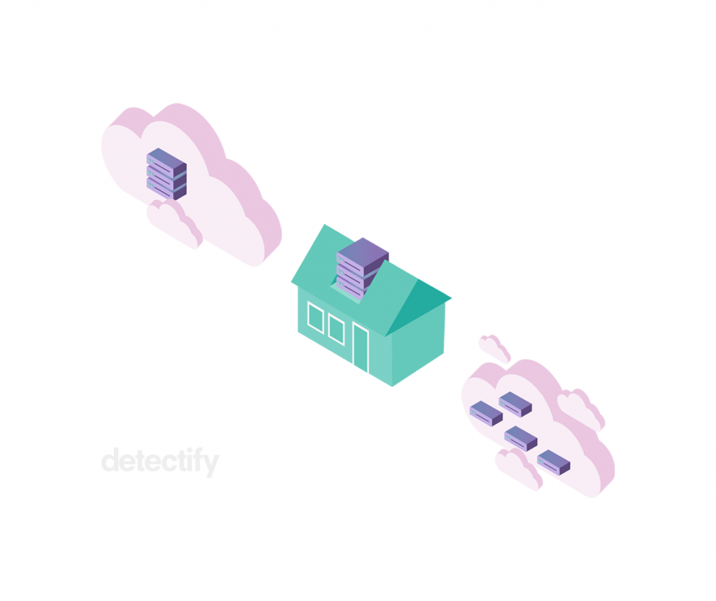
Cloud On Premises Serverless
By Andriana Solyna & Anna Hotsa

Slide 2

Agenda
On premises architecture
On cloud architecture
IaaS
PaaS
SaaS
Serverless
Comparison of approaches
Conclusion

Slide 3
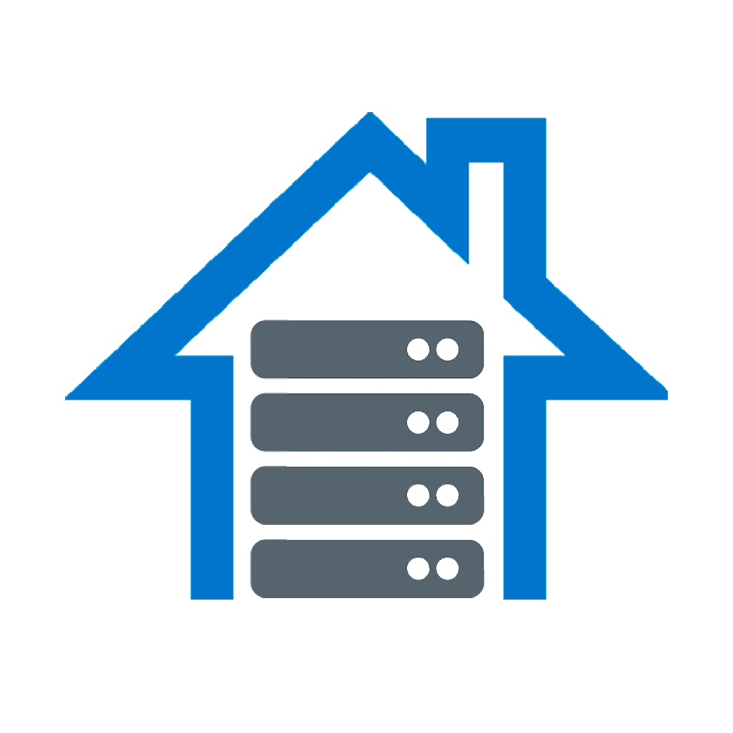
On Premises Architecture
On-premise software requires that an enterprise purchases a license or a copy of the software to use it. Because the software itself is licensed and the entire instance of software resides within an organization’s premises, there is generally greater protection than with a cloud computing infrastructure.

Slide 4
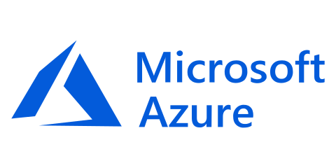
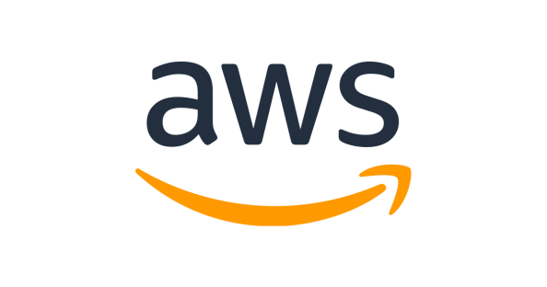
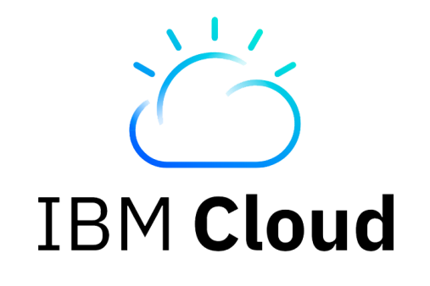
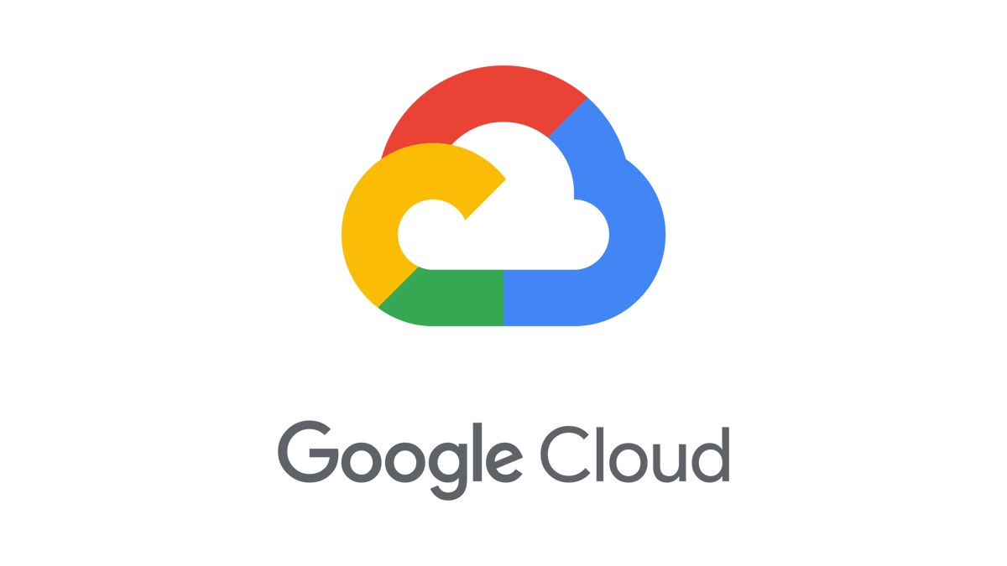
Cloud Architecture
In a cloud environment, a third-party provider hosts all your software components for you. These components typically consist of a front end platform (fat client, thin client, mobile device), back end platforms (servers, storage), a cloud based delivery, and a network (usually Internet).
This allows companies to pay on an as-needed basis and effectively scale up or down depending on overall usage, user requirements, and the growth of a company.

Slide 5
Types Of Cloud Computing
Cloud
IaaS
SaaS
PaaS

Slide 6
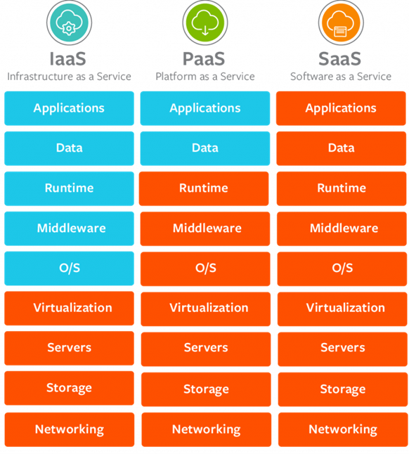

Slide 7

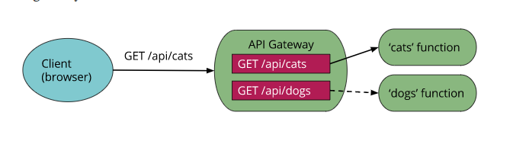
What is Serverless
Serverless can also be called Function as a Service, or FaaS. (AWS Lambda, Google Cloud Function etc.)
In a serverless solution you instead write code that is triggered by events
An example use-case would be to create a simple HTTP API-interface that creates an event when it receives a request
An example use-case would be to create a simple HTTP API-interface that creates an event when it receives a request.

Slide 8
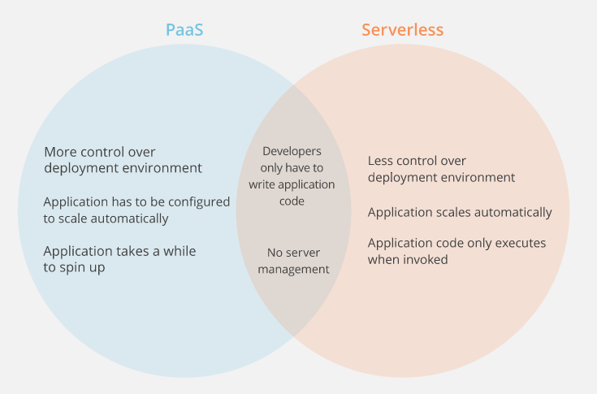
Serverless vs PaaS

Slide 9
Cloud vs On prem vs Serverless
Feature | On Cloud/Serverless | On Premises
Scalability | If your business demands increase, you can easily increase your cloud capacity without having to invest in physical infrastructure. | Not always possible to be scalable enough when business demands increase.
Cost | No need to spend money on: purchasing, maintaining equipment; hardware, facilities, utilities, or building out a large data center to grow your business IT teams to handle your cloud data center operations, as you can enjoy the expertise of your cloud provider’s staff. | Cost of server hardware, power consumption, space etc.

Slide 10
Cloud vs On prem vs Serverless
Feature | On Cloud/Serverless | On Premises
Control | You can easily decide which users have what level of access to what data. | Enterprises retain all their data and are fully in control of what happens to it, for better or worse. Companies in highly regulated industries with extra privacy concerns are more likely to hesitate to leap into the cloud before others because of this reason.
Security | Cloud offers many advanced security features that guarantee that data is securely stored and handled. | Company must have a certain level of security and privacy that an on-premises environment provides.

Slide 11
Conclusion
Use cloud ☺ (just kidding)
If you do not want to care about hardware and its management, choose cloud
If you need to have scalability in case business demand increases use cloud
If you do not trust cloud provider enough to store your private and important data, choose on- premises
But seriously, use cloud ☺

Slide 12
Thanks for attention ☺

